Slide 1

WELCOME BACK TO
MONEY BASICS
Facilitated by:
[Facilitator 1 name]
[Facilitator 2 name]

Slide 2
Banking Basics
Workshop 4
PG. 59 IN STUDENT GUIDE

Slide 3
Welcome Back!
Updates & Sharing:
How did the money saving homework go?
What community resource did you find?
How are your budgets going?
Today’s Agenda:
Learn about common banking terms and the different types of financial institutions.
Learn about common banking fees and how to avoid them.
How to open a bank account.
How to remedy a poor banking history.
Learn about the different types of checking accounts.
How to read and write a check.
How to balance a checkbook and why it’s important.

Slide 4
Community Agreements

Slide 5

Learning Objectives
Upon conclusion of Workshop 4, participants will:
Have learned at least three new banking terms and their meanings
Understand the differences and pros and cons between different types of financial institutions
Understand the most common banking fees and identify practical ways to minimize or avoid them
Understand the steps to opening a checking account
Identify steps to remedy poor banking histories
Understand the differences and pros/cons to different types of checking accounts
Understand how to read and write checks
Understand how to balance a checkbook and the importance of doing so

Slide 6

Banking Terms & Financial Institutions
TERMS
TYPES OF FINANCIAL INSTITUTIONS
Annual Percentage Rate (APR)
Finance Charge
Check Hold
Interest
Debit Card
Interest Rate
Delinquency
Overdraft
Federal Deposit Insurance Corporation (FDIC)
Service Charge
Commercial banks
Savings and loans associations
Credit unions
Internet Banks

Slide 7

Common Banking Fees
Monthly maintenance/service fee
ATM fees
Overdraft fees
Insufficient funds fees
Stop payment fees
Early withdrawal fees
Early closing fees
Low balance checking account fees
Excessive transaction fees

Slide 8

The 7 Steps to Opening a Bank Account
Choose an institution
Go to their website or a branch of the bank or credit union
Pick the product you want
Provide your information
Agree to terms
Print, sign, and mail
Congratulate yourself!

Slide 9

What to do if You Have a Poor Banking History
How might a person end up with poor banking history?
Cashing bad checks (or bouncing checks)
Making late payments on a loan or mortgage
Defaulting on a loan
Having a bank foreclose on a mortgage
Accruing overdraft fees (and not paying them off)
Failing to pay bank fees
Options:
1. Try to remedy the situation.
Obtain copies of your credit and Chex Systems reports
Pay off debts
Open a savings account
2. Open a “second-chance” checking account
Limited services but can help you rebuild your banking history
Bank and credit union options

Slide 10
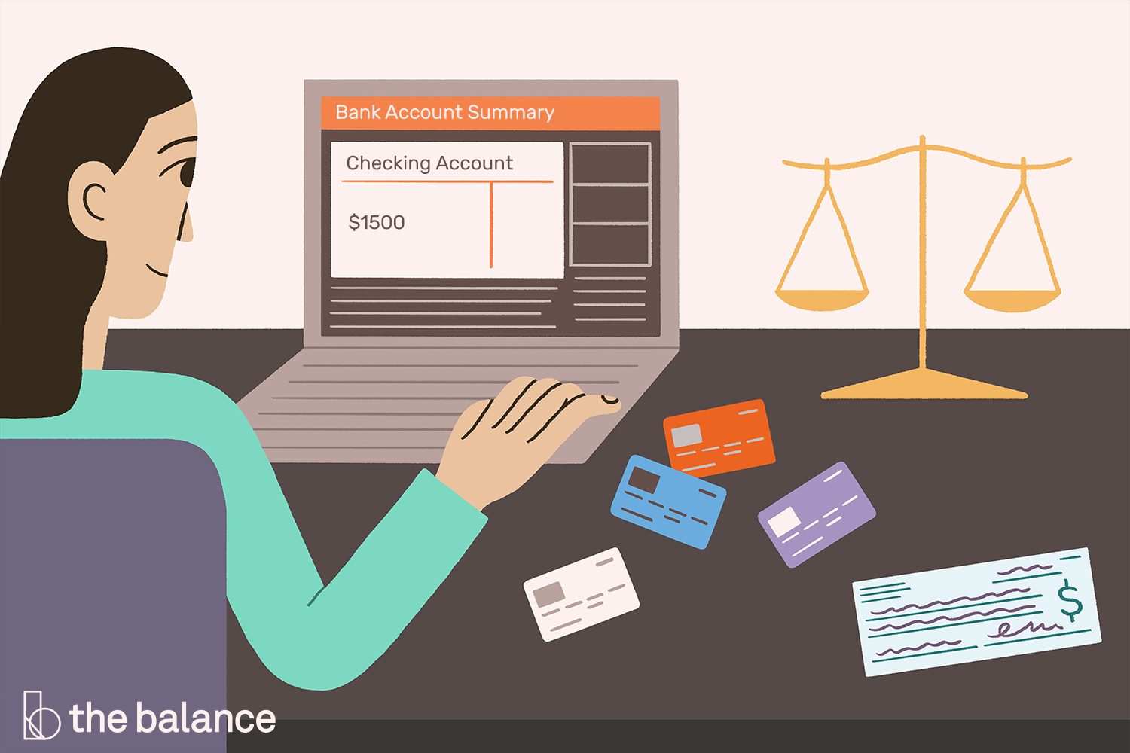
Checking Accounts
Different types of checking accounts:
Basic
Free
Interest-bearing
Joint-checking
Express
Lifeline
Senior/student checking
Money market

Slide 11
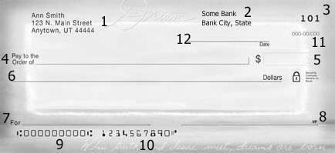
How to Read a Check

Slide 12
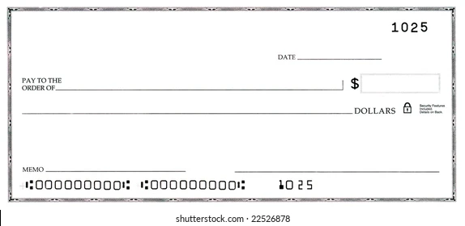
How to Write a Check
Choose a date
Choose a name
Choose an amount (numbers)
Choose an amount (in words)
Choose a memo / reason
Sign your check!

Slide 13
How to Balance a Checkbook
What you will need:
Your most recent bank statement and/or cancelled checks
A checkbook balancing form
Your checkbook register
A calculator and pencil
Step 1: Reconcile Your Checks.
Step 2: Reconcile Your Deposits.
Step 3: Reconcile Your ATM Withdrawals & Debit Card Purchases
Step 4: Record Interest Earned & Bank Fees.
Step 5: List Outstanding Checks.
Step 6: List Outstanding Deposits.
Step 7: Record Your Bank's Ending Balance.
Step 8: Enter Outstanding Deposits.
Step 9: Enter Outstanding Checks.
Step 10: Calculate Your Balance.
https://www.youtube.com/watch?v=Aw2Wn7Wmp7c
https://www.youtube.com/watch?v=vXsavJrK9Ng

Slide 14
Check Writing & Budgeting Game
CONGRATULATIONS!
You have just started a new job and your income is now exactly $3,000.00 per month after taxes. You have deposited your first paycheck of $3,000.00 into your checking account. With that money, you will need to choose three things to get you started:
Home: a place to live
Transportation: How you will get around, and to and from your job
Wellness: Something that you feel will help you to feel happy and well.
As you make your choices, you will need to write checks and balance your “checkbook” as you go along.

Slide 15
Checkbook Template:
NUMBER OR CODE | DATE | TRANSACTION DESCRIPTION | PAYMENT FEE, WITHDRAWAL |  | DEPOSIT, CREDIT |  | $

Slide 16
Instructions
Step 1: Pay your bills using practice checks
Step 2: Go shopping for home, transportation, and wellness. Choose an option and write a check.
Make check payable to: | Amount:
Hot & Cold Power Company | $57.93
Few Channels Cable Company | $65.34
You Deserve Some Credit Company | $60.00

Slide 17


Housing Options
Option 1:
Bedroom in a shared house
Rent: $450/month
Pros: Inexpensive
Cons: Must share common space
Pay to: Friendly Living Company
Option 2:
Shared two-bedroom apartment
Rent: $700/month
Pros: Less expensive than living alone
Cons: Must share common space with another person
Pay to: Standard Property Company

Slide 18


Housing Options (continued)
Option 3:
Studio apartment
Rent: $850/month
Pros: Close to downtown and work, walkable
Cons: More expensive, not a lot of space
Pay to: Dollhouse properties
Option 4:
One-bedroom apartment
Rent: $1100/month
Pros: More personal space
Cons: More expensive
Pay to: American Property Management

Slide 19


Housing Options (continued)
Option 5:
Small home
Mortgage: $1150/month
Pros: Over time, you will own the home
Cons: Needs some repairs and updates; put all savings into down payment
Pay to: Happy Homes Mortgage Company
Option 6:
Large suburban home
Mortgage: $1800/month
Pros: Plenty of living space
Cons: Long commute to work; put all savings into down payment
Pay to: Megabank Home Loans

Slide 20
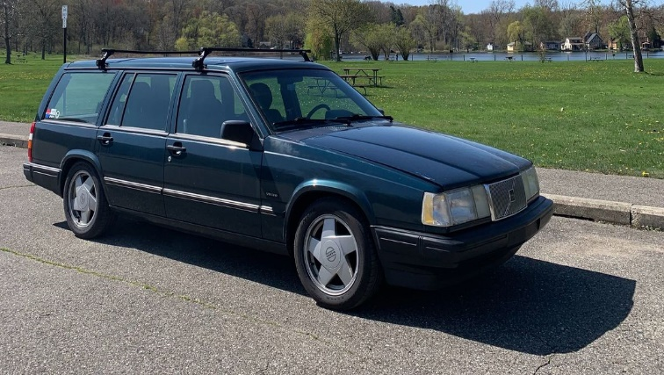
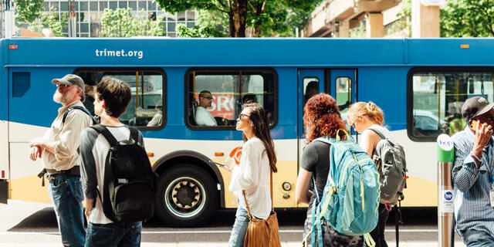
Transportation Options
Option 1:
Bus pass
$95/month
Pros: Inexpensive; better for the environment
Cons: Commute takes longer; limits where you can go
Pay to: City Transportation
Option 2:
Basic used car
$1,800 one-time payment
Pros: Inexpensive
Con: Needs repairs and maintenance
Pay to: Happy Auto

Slide 21


Transportation Options (continued)
Option 3:
Basic new car
$280/month five-year loan
Pros: Reliable transportation
Cons: More expensive, regular payments you need to make each month
Pay to: Sam’s New Cars
Option 4:
Leased luxury car
$650/month three-year lease
Pros: Luxurious car you’ve always dreamed of
Cons: Very expensive; long-term loan
Pay to: Fast & Fun Auto

Slide 22


Wellness Options
Option 1:
Community Fair Outing
$20 entrance fee
Pros: Inexpensive
Cons: Crowded with long lines
Pay to: Community Events
Option 2:
Day at the Spa
$125
Pros: Relaxing and rejuvenating; self-care
Cons: Expensive for one day
Pay to: Dreamscape Spa

Slide 23

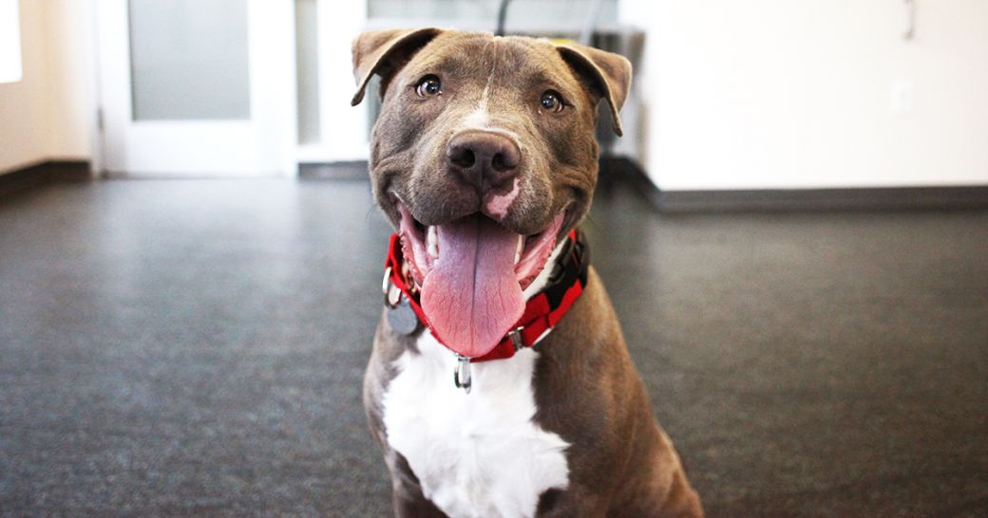
Wellness Options (Continued)
Option 3:
Adopt a dog
$400 adoption fee
Pros: Provides unconditional love and companionship
Cons: Ongoing cost for food and care
Pay to: County Animal Shelter
Option 4:
New Gaming Station & Games
$460
Pros: Provides at-home entertainment
Cons: Initial cost is expensive
Pay to: Super Electronics

Slide 24


Wellness Options (continued)
Option 5:
60’ High Definition Television
$800
Pros: Provides at-home entertainment
Cons: Initial cost is quite expensive
Pay to: E-Mart
Option 6:
One Week All-Inclusive Resort Vacation
$1600
Pros: Very luxurious and relaxing vacation
Cons: Very expensive
Pay to: Serene Vacations

Slide 25
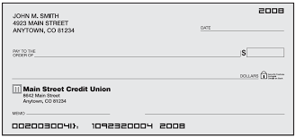
Make Your Purchases
Step 3: Write 3 checks – one for housing, one for transportation, and one for wellness.

Slide 26

Collect Coins
Step 4: How many points did you collect for each item?
Did you notice the correlation between your expense choices and the amount of points you were able to collect?

Slide 27

Wrap-Up
Thank you all for your participation!
Are there any questions?
Homework:
Choose one more money saving idea and commit to it for the week. Keep track of which ideas are going well and which are not.
Continue using your budget for the next week and revise it if needed.
Research any fees charged at your bank or a bank you are interested in.

